Slide 1

Natural Language Processing
Speakers:
Abhishek Parikh, Twisha Naik, Nisarg Vyas

Slide 2
Natural Language Processing
Natural Language Processing (NLP) is an area of computer science and artificial intelligence concerned with the interactions between computers and human (natural) languages.
In particular how to program computers to process and analyze large amounts of natural language data.

Slide 3
Natural Language Processing
Computer Science
NLP
Artificial
Intelligence
Computational Linguistics

Slide 4
Natural Language
Natural Language refers to the way we, humans, communicate with each other.
Types:
Text
Speech

Slide 5
Natural Language
Natural language is primarily hard because it is messy.
There are few rules.
And yet we can easily understand each other most of the time.
Natural Language is highly ambiguous.
Example:
Woman, without her man, is helpless.
Woman! Without her, man is helpless!
Homophones and Homonyms

Slide 6
Applications of Natural Language Processing
Text recognition
Speech recognition
Natural language generation

Slide 7
From Natural Human Language to Linguistics
What do you mean by Linguistics?
Linguistics is the scientific study of language, including its grammar, semantics, and phonetics
Classical Linguistics
Computational Linguistics

Slide 8
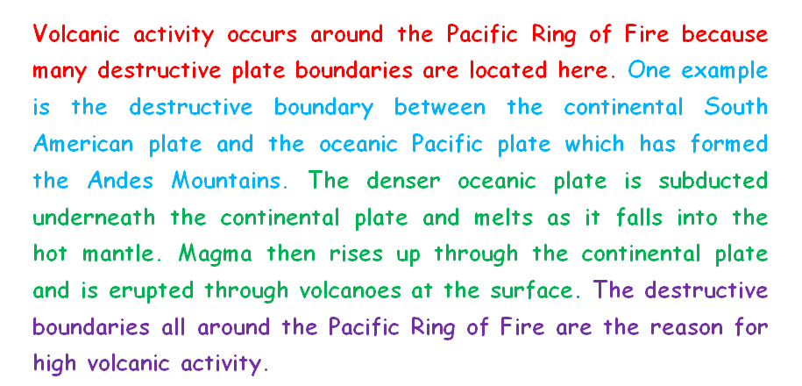
Let us understand the process!

Slide 9
Understanding the process!
Cleaning the data.
Breaking documents into paragraphs.
Breaking paragraphs into sentences.
Breaking sentences into words.
Grammar
Focusing on words - their meanings, synonyms and their usages.
Lemmatization and Stemming
Part of Speech (Verb, Noun, Adjective, Adverb, Number etc.)
Named Entity Relation
Keyword recognition

Slide 10
Sentence Boundary Detection
Sentence Boundary Detection is a problem in itself.
There. Are various way! To detect Sentence Boundary.
Why do we do Sentence Boundary Detection?
So that we have to look at a smaller sentence and decide the next steps!
Long sentences are difficult for a normal human being to read. And so for a machine to understand!
Erroneous Sentence Boundary might lead to loss of important data semantics.

Slide 11
From Sentences to Words
Breaking the stone into minute pieces - cleaning, experimenting and polishing might lead to diamonds.
English is much easier language because we can split sentences on white-spaces to get the words.
But it is a challenge for many different languages.

Slide 12
Stemming and Lemmatization
“Word normalization.”
The goal of both stemming and lemmatization is to reduce inflectional forms and sometimes derivationally related forms of a word to a common base form.
Stemming: Stemming is the process of converting the words of a sentence to its non-changing portions.
Example : The stem of amusing, amusement, and amused would be “amus”.
Different types of Stemmers, used commonly: Lancaster Stemmer, Porter Stemmer. Snowball Stemmer etc.
Lemmatization: Lemmatization is the process of converting the words of a sentence to its dictionary form.
Example: Lemma for amusement, amusing, and amused will be “amuse”.
Lemma for “women” will be “woman”

Slide 13
WordNet and Synsets
WordNet is a lexical database for the English language.
Nouns, verbs, adjectives and adverbs are grouped into sets of cognitive synonyms (synsets), each expressing a distinct concept.
Synsets are interlinked by means of conceptual-semantic and lexical relations.
WordNet superficially resembles a thesaurus, in that it groups words together based on their meanings.
Synsets: Synonyms--words that denote the same concept and are interchangeable in many contexts--are grouped into unordered sets.
For more details go to: https://wordnet.princeton.edu/

Slide 14
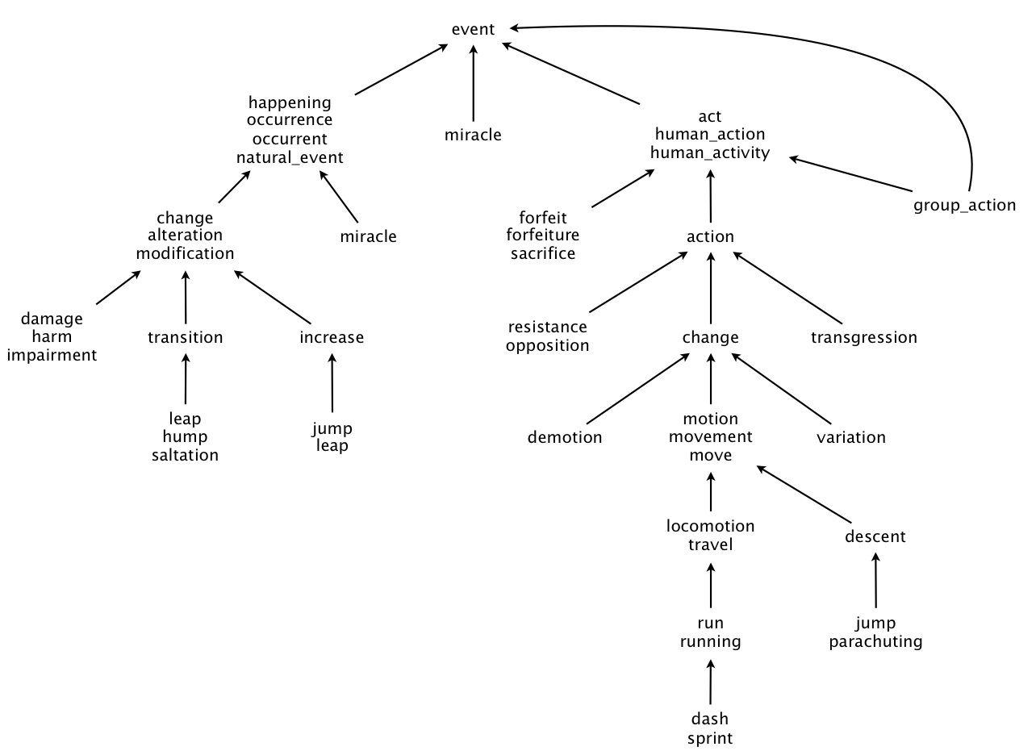
WordNet and Synsets

Slide 15
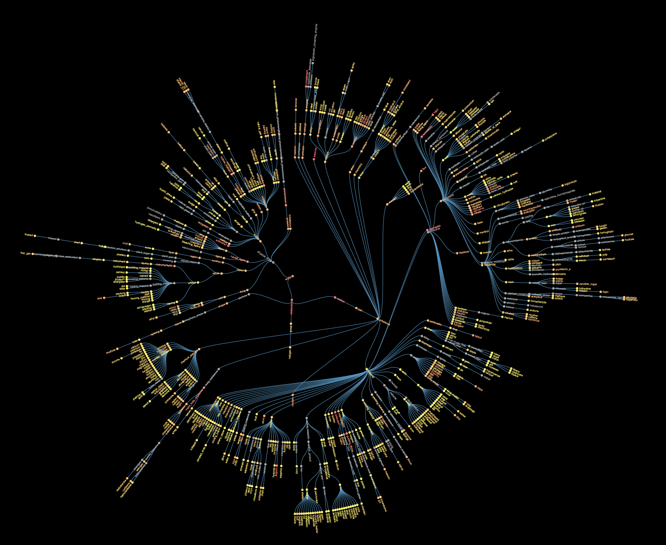
WordNet and Synsets

Slide 16
Stanford Core NLP
Stanford CoreNLP provides a set of human language technology tools.
It can give the base forms of words, their parts of speech, whether they are names of companies, people, etc., normalize dates, times, and numeric quantities, mark up the structure of sentences in terms of phrases and syntactic dependencies, indicate which noun phrases refer to the same entities, indicate sentiment, extract particular or open-class relations between entity mentions, get the quotes people said, etc.
Stanford CoreNLP integrates many tools including the part-of-speech (POS) tagger, the named entity recognizer (NER), the parser, the coreference resolution system, sentiment analysis, bootstrapped pattern learning, and the open information extraction tools.
More details can be found at: https://stanfordnlp.github.io/CoreNLP/

Slide 17
Stanford Core NLP
Tokenization
Sentence Splitting
Lemmatization
Parts of Speech
Named Entity Recognition
Dependency Parsing
Coreference Resolution
Natural Logic
Open Information Extraction
Sentiment

Slide 18
Stanford Core NLP
Part-of-Speech (POS):
A category or a class to which a word is assigned in accordance with its syntactic functions.
In English the main parts of speech are noun, pronoun, adjective, determiner, verb, adverb, preposition, conjunction, and interjection.
Name-Entity-Relation (NER):
For English, by default, this annotator recognizes named (PERSON, LOCATION, ORGANIZATION, MISC), numerical (MONEY, NUMBER, ORDINAL, PERCENT), and temporal (DATE, TIME, DURATION, SET) entities.
12 classes by default.
Stanford Core NLP visualisation at: http://nlp.stanford.edu:8080/corenlp/

Slide 19
Dependency Parsing
Relations among the words are illustrated above the sentence with directed labeled arcs, from heads to dependents. This is called Dependency Structure.
When this Dependency Structure is parsed it form a tree like structure called Dependency Tree.
It always has a root node that marks the root of the tree and head of the entire structure.
The relationship between nodes directly encode important information that is often buried in complex sentences.

Slide 20
NLTK
Natural Language Toolkit (NLTK) is a platform for building Python programs to work with human language data.
It provides easy-to-use interface to over 50 corpora and lexical resources.
It provides text processing libraries for classification, tokenization, stemming, tagging, parsing, and semantic reasoning.

Slide 21
spaCy
spaCy is an open-source software library for advanced Natural Language Processing, written in the programming languages Python.
It offers the fastest syntactic parser in the world.
spaCy handles large-scale extraction tasks
For more information go to: https://spacy.io/

Slide 22
spaCy
Features
Tokenization
Named entity recognition
Support for 28+ languages
13 statistical models for 8 languages
Pre-trained word vectors
Easy deep learning integration
Part-of-speech tagging
Labelled dependency parsing
State-of-the-art speed
Robust, rigorously evaluated accuracy

Slide 23
What next?
So, we saw different methods to normalize words, find linguistic and semantics relations between them but what do we do with it?
Or the real question is how to convert the human language to machine understandable language.
That’s where Vectors comes into play!

Slide 24
Why and What is Vectorization?
The ability to process natural human language is one of the things that makes machine learning algorithms so powerful.
However, when doing natural language processing, words must be converted into vectors that machine learning algorithms can make use of.
If a word can be translated into a single number, documents can be translated to a vector.
Due to varsity of words, these vectors tend to be high-dimensional.
This whole process of representing text data into numbers is called “Embedding” or “Vectorization”.

Slide 25
Machine friendly representation of documents
Machines are not able to interpret language in the way humans do.
Machines understand numbers and hence arises a need to convert words, sentences and documents into machine interpretable numerical form.

Slide 26
Bag-of-Words (BoW) Model
What is the best representation of documents in numerical form?
Concept of Vocabulary
Notes:
Talk about vectors
Unordered way of looking at documents (Ignore the context!) -- The property of BoW model
To form a vector we need a vocab

Slide 27
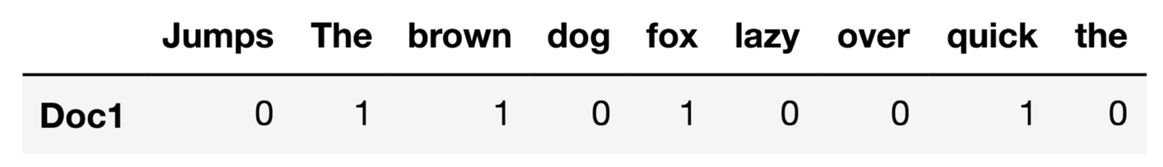
Count Vectorizer
Simplest model which counts the frequency of words in a document to create a document vector.
Count the number of times each term in the vocabulary appears in the document.
The vector formed by this model is nothing but a frequency vector of vocabulary words.
Sample Document: “The quick brown fox. Jumps over the lazy dog!”

Slide 28
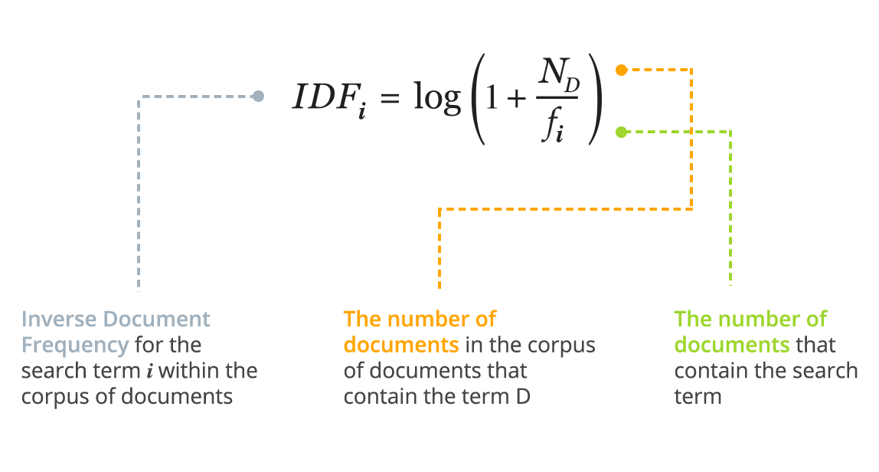
Term Frequency - Inverse Document Frequency (TF-IDF)
TF_{i,D} = (Number of times the term i appears in the document D) / (Total number of words in the document D)
TF-IDF = TF * IDF

Slide 29
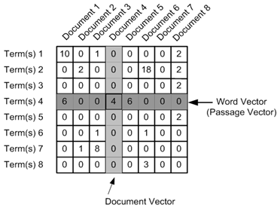
TF-IDF Matrix representation of corpus of documents

Slide 30
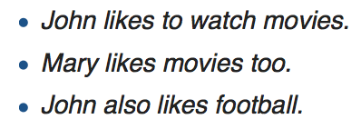
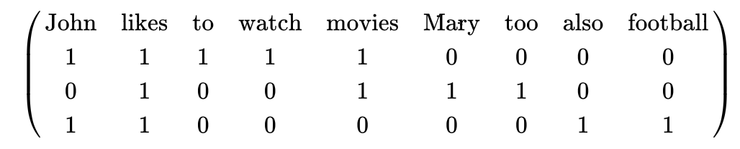
Hashing Vectoriser
When we create vectors by using vocabulary, it utilizes a lot of memory.
Let’s take the example of three documents: (Vocab size = 9)

Slide 31
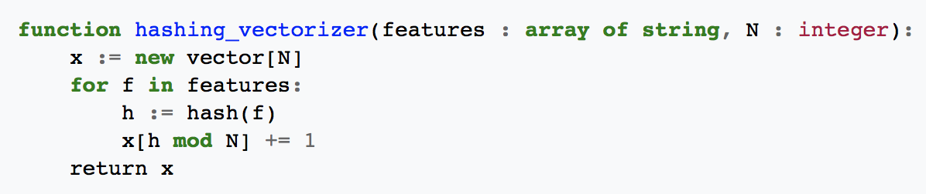
Hashing Vectoriser
Instead of building a vocabulary and using that as feature, we define a hashing function which will help us generate a vector of a pre-defined length by hashing the original features.
Example:
Suppose, our feature vector is ["cat","dog","cat"] and hash function is: hash("cat") = 1 and hash("dog")=2.
Suppose, output feature vector dimension (N) to be 4. Then output x will be [0,2,1,0].

Slide 32
Recap
Need of vectors
Bag of Words (BoW) Model
Count Vectorizer
TF-IDF Vectorizer
Hashing Vectorizer

Slide 33
Why vectors?
One of the main focus of NLP is to compare different documents and look at the similarity between documents.
The vector representation of the documents makes the calculation of similarity very easy.
Let’s discuss one of the commonly used similarity measures

Slide 34
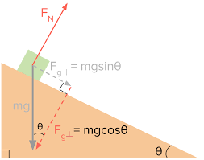
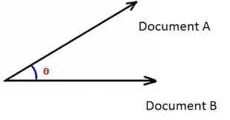
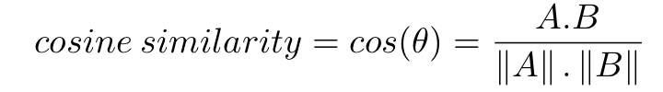
Cosine Similarity

Slide 35
n-gram Model
Bag of Words Model considered each word independently.
n-gram predicts the sequence of words.
“n” in n-gram denotes the length of sequence. Based on varying “n” we have:
n=1 - monograms / unigrams
n=2 - bigrams / digrams
n=3 - trigrams and so on...

Slide 36

n-gram Model
n-gram computes the probability of ith item given a sequence of previous (i-1) items.
For Example, we want the machine to learn that the words “Machine” & “Learning” are commonly used together. “Machine Learning” is a bigram.
The probabilities are estimated using the relative frequencies of observed outcomes. This process is called Maximum Likelihood Estimation (MLE).
Notes:
MLE??????

Slide 37
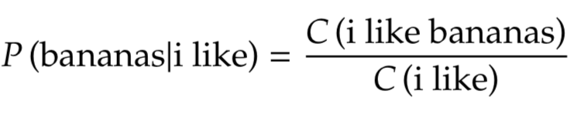
Example
Compute probability of trigram: “I like bananas”
Notes:
???? DOUBTS HERE

Slide 38
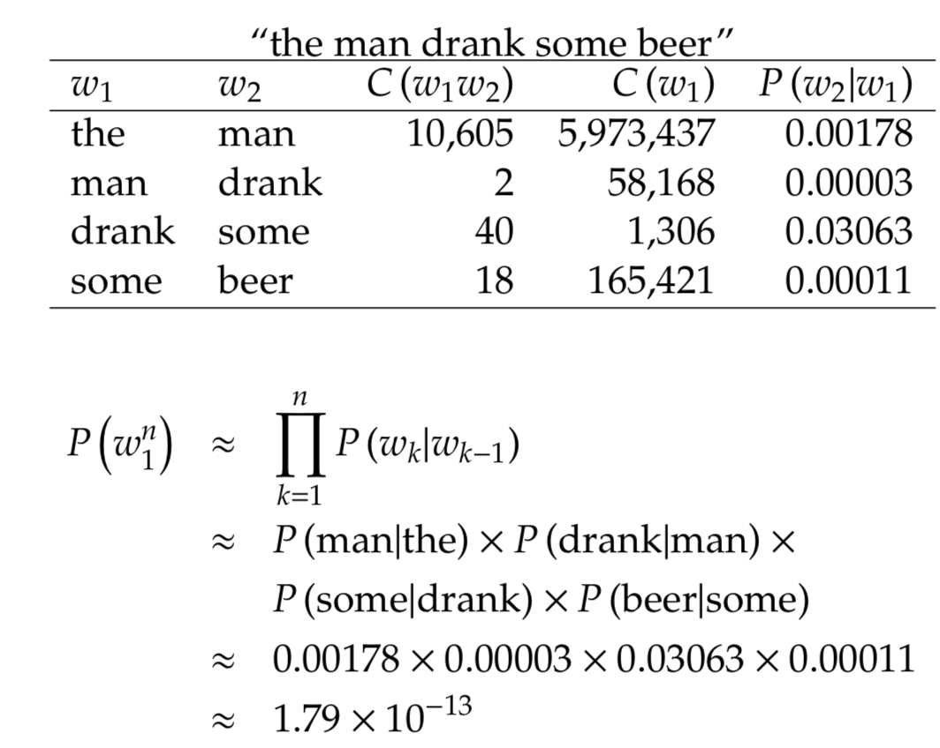
Example: Estimate sequence using bigrams
Assumption: Probability of next word depends only on previous word.

Slide 39
Skip-Gram Model
The issue with BoW models is the lack of context.
Skip-gram model tries to learn the context in which each word is used.
Given a central word, it will predict it’s neighbouring words with different probabilities.

Slide 40
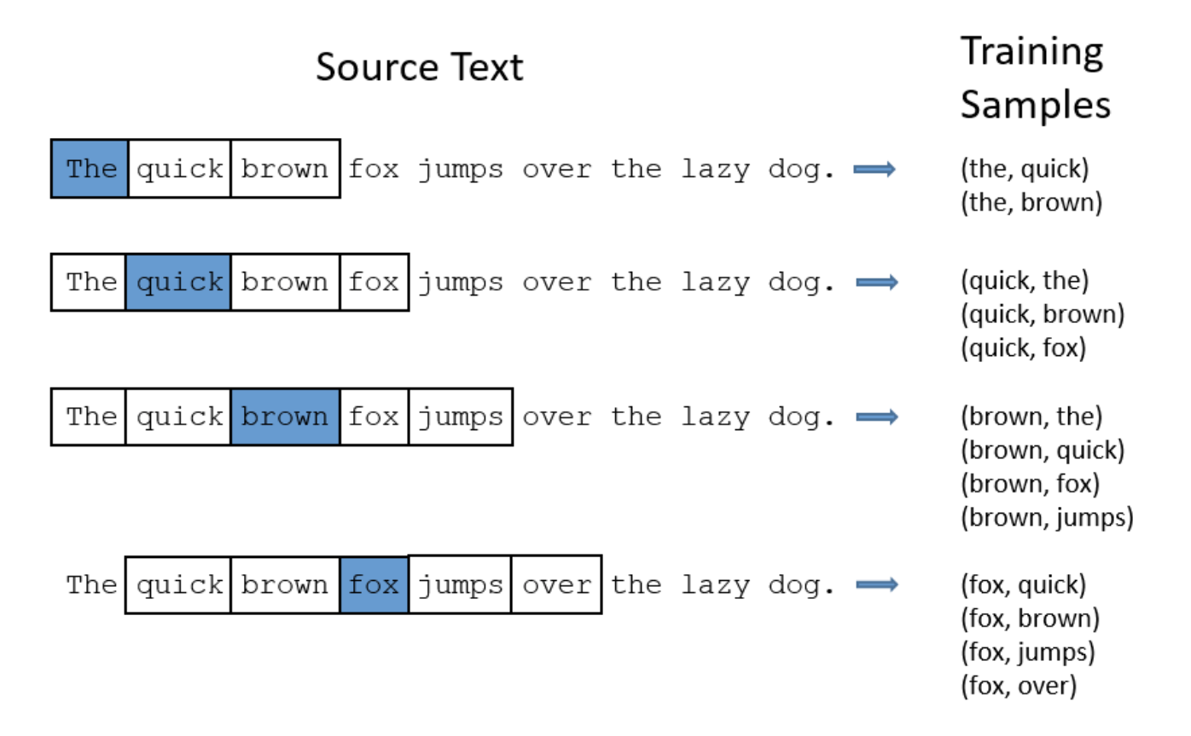
Generation of Training data

Slide 41
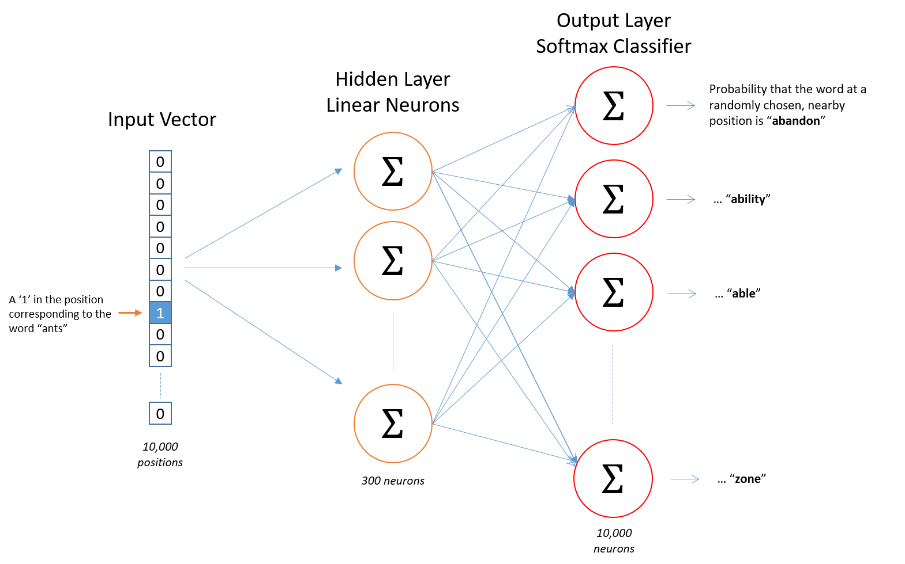
Architecture of Skip-gram Model

Slide 42
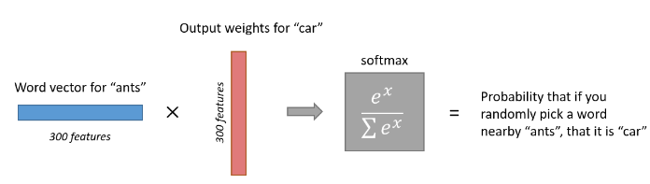
Interpretation of Skip-Gram Output

Slide 43
Word2Vec
This model is used for learning vector representations of words, called “Word Embeddings”.
These models are shallow, two-layer neural networks that are trained to reconstruct linguistic contexts of words.
Word2vec takes as its input a large corpus of text and produces a vector space, typically of several hundred dimensions, with each unique word in the corpus being assigned a corresponding vector in the space.
Word vectors are positioned in the vector space such that words that share common contexts in the corpus are located in close proximity to one another in the space.
Use “gensim” library to use the existing word vectors like GloVe, GoogleNews-vectors-negative300 etc. Standard words vectors are open-source and available freely.

Slide 44
GloVe
GloVe : Global Vectors for Word Representation
GloVe is an unsupervised learning algorithm for obtaining vector representations for words. Training is performed on aggregated global word-word co-occurrence statistics from a corpus, and the resulting representations showcase interesting linear substructures of the word vector space.
Trained on extremely large data set, GloVe comes in a variant from 50D to 300D.
The main intuition underlying the model is the simple observation that ratios of word-word co-occurrence probabilities have the potential for encoding some form of meaning.

Slide 45
GloVe
The training objective of GloVe is to learn word vectors such that their dot product equals the logarithm of the words' probability of co-occurrence.
Owing to the fact that the logarithm of a ratio equals the difference of logarithms, this objective associates (the logarithm of) ratios of co-occurrence probabilities with vector differences in the word vector space.
Because these ratios can encode some form of meaning, this information gets encoded as vector differences as well.
For this reason, the resulting word vectors perform very well on word analogy tasks, such as in the word2vec package.

Slide 46
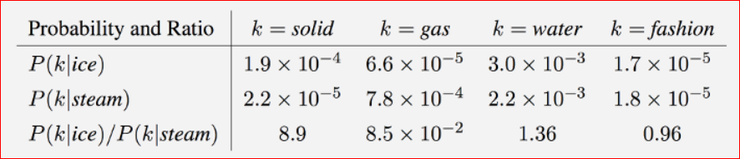
GloVe
As one might expect, ice co-occurs more frequently with solid than it does with gas, whereas steam co-occurs more frequently with gas than it does with solid.
Both words co-occur with their shared property water frequently, and both co-occur with the unrelated word fashion infrequently.

Slide 47
GloVe
Only in the ratio of probabilities does noise from non-discriminative words like water and fashion cancel out, so that large values (much greater than 1) correlate well with properties specific to ice, and small values (much less than 1) correlate well with properties specific of steam.
In this way, the ratio of probabilities encodes some crude form of meaning associated with the abstract concept of thermodynamic phase.

Slide 48
Topic Modeling
Aim : We have N “documents”, we want to categorize them into K topics, based on their similarity.
Assumptions : We do not know have any prior information about the topics. We only have the N documents, and we have a fixed “K”.
Applications
News classification
Document type classification (Legalsifter)
Extremely important step in search (Google, Bing ….)
Email filters , spam classification ….
Pro tip : This is very similar to clustering. All we have to figure out is how to cluster on text!

Slide 49
Topic Modelling methods
Clustering after some pre-processing (Simplest and most popular)
Explicit Semantic Analysis (ESA) we will cover this today. Rest tomorrow.
-------------------------------------------------------------------------------------
Latent Semantic Indexing (LSI)
pLSI - probabilistic LSI
LDA (Latent Dirichlet Allocation)
Key : Don’t go by the big and complicated names, most concepts are simple :)

Slide 50
Term frequency Histogram
Let’s say there is a “document” (Document in NLP could be as small as a sentence or two!)
Our document is:
“This is a session of summer school at DAIICT. The portal of the event is called "Captive". However, we are not keeping you captive! Hope you are learning machine learning!”

Slide 51
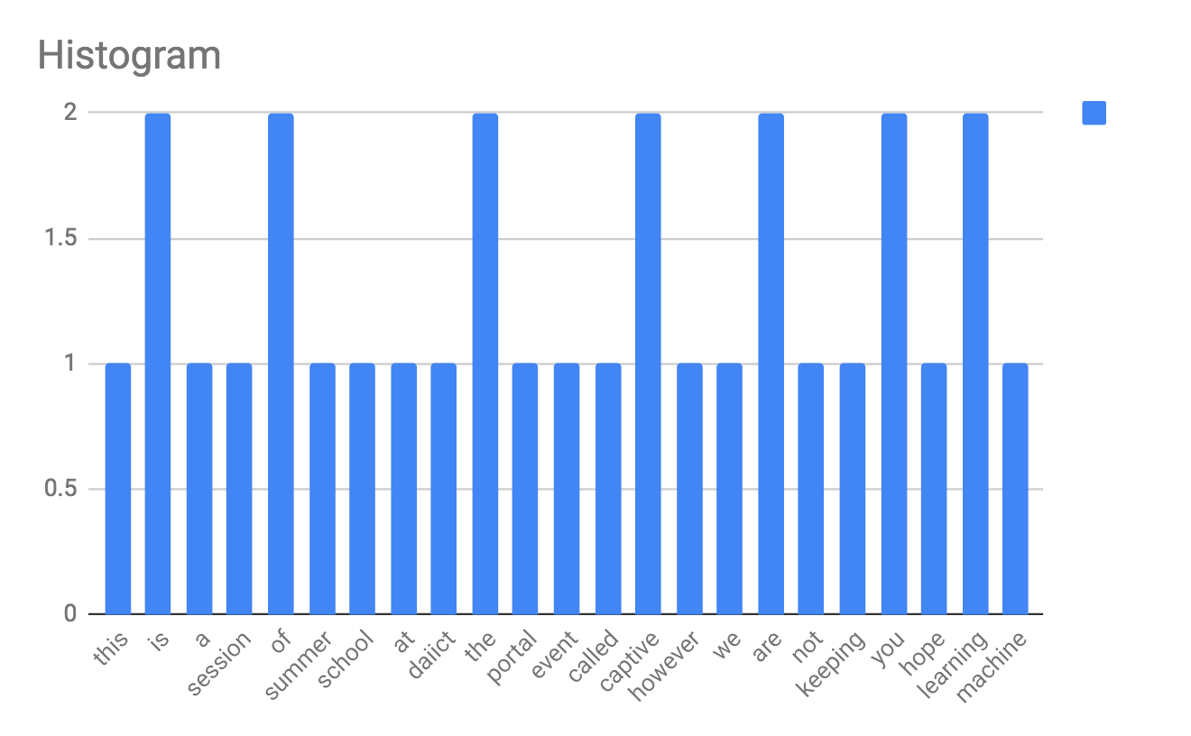
Term frequency Histogram

Slide 52
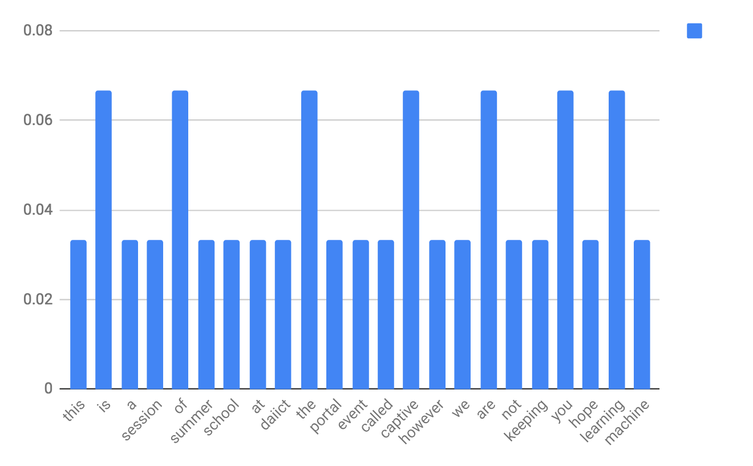
Term frequency Histogram
Important to normalize the document! We shall see soon.

Slide 53
What is a vocabulary in topic modeling context
Let’s make things a “slightly more” interesting : Let’s add one more document
“DAIICT captive portal network password”
“network” and “password” are the new words.
Vocabulary is union of all the words from all the documents.

Slide 54
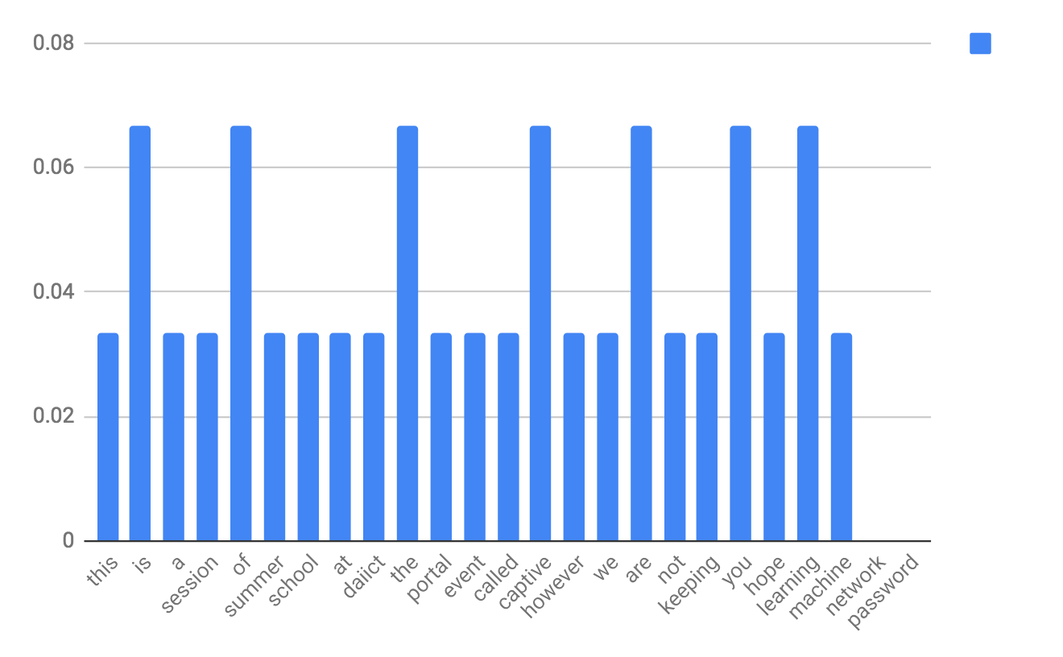
Explicit Semantic Analysis. Our term frequency histogram has to change!
Note: network and password now come into our histogram. With 0 probability. This is called a full-vocabulary histogram.

Slide 55
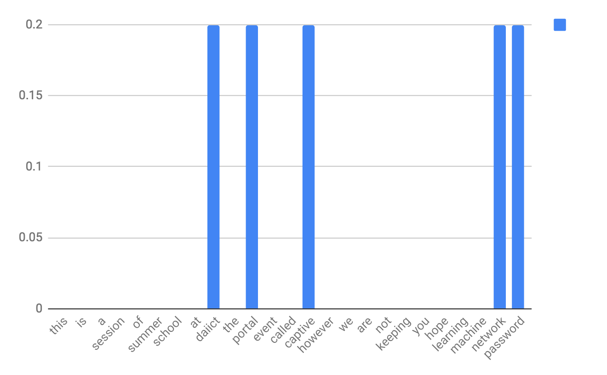
Full-vocabulary Histogram for sentence 2
“DAIICT captive portal network password”

Slide 56
This can be formed as a vector! Perfect for Linear Algebra

Slide 57
Clustering for topic modeling
Like any topic modeling problem : we just start with N documents first.
First step: Find out the total vocabulary V
Second step : Make a full-vocabulary term frequency histogram out of it.
Third step : We already have vectorized our text, Voila! Apply k-means (and many other utilities)

Slide 58
Explicit semantic analysis
Like any topic modeling problem : we just start with N documents first.
First step: Find out the total vocabulary V
Second step : Make a full-vocabulary term frequency histogram out of it.
Third step : Make an “inverted index” : This finds occurrences of words within the document. It’s a word’s representation in the document space

Slide 59
Inverted Index
Document1 : “This is a session of summer school at DAIICT. The portal of the event is called "Captive". However, we are not keeping you captive! Hope you are learning machine learning!””
Document2 : “DAIICT captive portal network password”
 | Document1 | Document2
Captive | 1 | 1
Portal | 1 | 1
Network | 0 | 1
summer | 1 | 0
... | ... | ...
... | ... | ...
... | ... | ...
... | ... | ...
... | ... | ...
... | ... | ...

Slide 60
Normalize the inverted Index
Document1 : “This is a session of summer school at DAIICT. The portal of the event is called "Captive". However, we are not keeping you captive! Hope you are learning machine learning!””
Document2 : “DAIICT captive portal network password”
 | Document1 | Document2
Captive | 0.003 | 0.2
Portal | 0.003 | 0.2
Network | 0 | 0.2
summer | 0.003 | 0
... | ... | ...
... | ... | ...
... | ... | ...
... | ... | ...
... | ... | ...
... | ... | ...

Slide 61
Inverted Index in the real world
In reality, there are MANY documents (N is large).
 | Document1 | Document2 | Document3 | Document4 | Document5 | ... | ... | ... | DocumentN
Captive | 0.03 | 0.2 | 0.004 | 0 | 0.001 | 0.001 | 0.1 | 0
Portal | 0.03 | 0.2 | 0.003 | 0 | 0.001 | 0 | 0.05 | 0 | 0.2
Side tidbit : Google

Slide 62
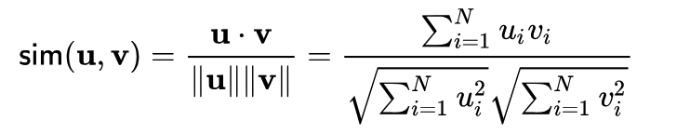
Linear Algebra Alert!
 | Document1 | Document2 | Document3 | Document4 | Document5 | ... | ... | ... | DocumentN
Captive | 0.03 | 0.2 | 0.004 | 0 | 0.001 | 0.001 | 0.1 | 0
Portal | 0.03 | 0.2 | 0.003 | 0 | 0.001 | 0 | 0.05 | 0 | 0.2
Each word is of fixed N-dimensions. We can apply linear algebra to find “similarity” between words. Similarity here is words co-occurring in the set of document together.

Slide 63
Explicit Semantic Analysis
We are able to find association of the words as seen by our document. Keep the words that have high similarity (greater than the threshold) among each other in one “group”.
For example : groupA (“captive”, “cell”, “dungeon”, “bunker”, “prisoner”, “DA-IICT”,”portal”)
groupB (“flower”, “bloom”, “leaves”, “photosynthesis”, ….)
We can sum up the group vectors directly.

Slide 64
Vector Summing up
 | Document1 | Document2 | Document3 | Document4 | Document5 | ... | ... | ... | DocumentN
Captive | 0.03 | 0.2 | 0.004 | 0 | 0.001 | 0.001 | 0.1 | 0
Portal | 0.03 | 0.2 | 0.003 | 0 | 0.001 | 0 | 0.05 | 0 | 0.2
groupA | 0.06 | 0.4 | 0.007 | 0 | 0.002 | 0.001 | 0.15 | 0 | 0.2

Slide 65
“Group” Similarity
groupA | 0.06 | 0.4 | 0.007 | 0 | 0.002 | 0.001 | 0.15 | 0 | 0.2
groupB | 0.1 | 0.4 | 0.027 | 0 | 0.3 | 0.001 | 0 | 0.2 | 0.3
... | ... | ... | ... | ... | ... | ... | ... | ... | ...
groupG | 0.1 | 0.4 | 0.027 | 0 | 0.3 | 0.001 | 0 | 0.2 | 0.3
Now the cosine similarity can be applied across “groups”.

Slide 66
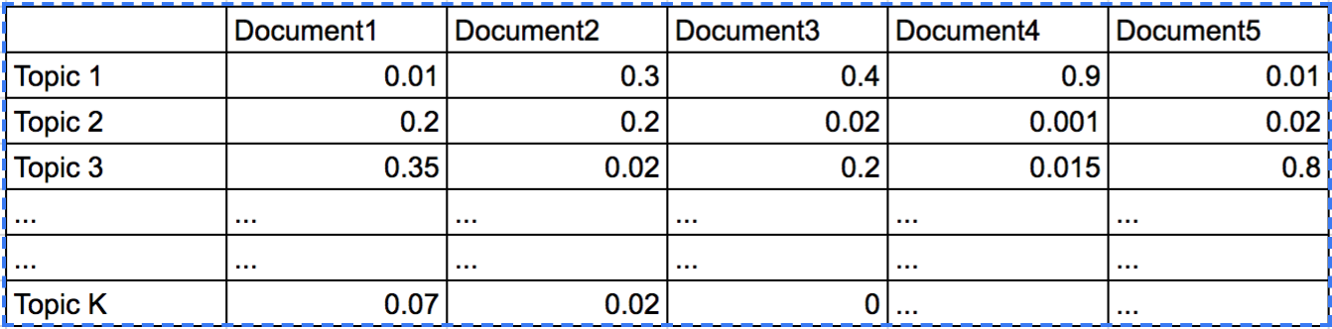
Explicit Semantic Analysis
We came from words to “groups” similarity, then “groups” similarity can give us more “groups”.
This iterative process finally gives us “K” known concepts, with each document’s participation in it.
Egozi, Ofer; Markovitch, Shaul; Gabrilovich, Evgeniy (2011). "Concept-Based Information Retrieval using Explicit Semantic Analysis" (pdf). ACM Transactions on Information Systems. 29

Slide 67
Latent Semantic Indexing
LSI is very similar to ESA, it is a time-and-space optimized version of ESA
LSI had to exist, because as we see in ESA
the first step was to make a vector for each word, each having D dimensions. Very quickly, that entire matrix becomes large enough not to fit in RAM.
Moreover, the word x document matrix is really a sparse matrix.
A linear Algebra technique called SVD (Singular Value Decomposition) is used to reduce a large matrix into smaller, representative constituent matrices.
This is similar to PCA you learned earlier.

